Slide 1
Benefits Data Trust
Helping people today, modernizing benefits access for tomorrow
Jillian Humphries, Policy Manager
February 7, 2023

Slide 2
Hunger Free Communities Presentation
BDT: who we are and what we do
WIC Toolkit
DSA Playbook
SNAP-Medicaid Coordination Survey

Slide 3
About BDT
Benefits Data Trust (BDT) is a national nonprofit harnessing the power of data, technology, and policy to provide efficient and dignified access to assistance, improving people's health and financial security.

Slide 4
BDT Vision
We envision a world that connects people to essential benefits and services while treating them with dignity and respect.
Lower healthcare costs, more efficient government, and people who are healthy, economically mobile, and thriving.

Slide 5
The Problem
$80 billion in benefits left on the table each year ¹
More than 1 in 10 Americans living in poverty ²
More than 9 million people missing out on benefits ³
Sources: 1: BDT estimate based on publicly available data for WIC, SNAP, Medicaid, CHIP, EITC, and Pell Grants
2: "Income and Poverty in the United States: 2019." United States Census Bureau
3: BDT estimate based on publicly available data on benefit participation gaps
Notes:
Sources 1:This is a BDT-generated estimate that includes WIC,SNAP, QMB/SLMB, Medicaid, CHIP, EITC, and Pell Grants
2: "Income and Poverty in the United States: 2019." United States Census Bureau.
3: This is a BDT-generated estimate based on publicly available data on benefit participation gaps. NOTE: this is based on the fact that there are approx. 9M individuals who are eligible but not enrolled in Medicaid/CHIP alone (plus we know there's ~7M each for SNAP and WIC, but we have no good way to estimate the overlap across programs to get a count of unique individuals). Not sure how much detail we want to provide in the citation here.

Slide 6
Why Benefits Matter: Improved Outcomes
SNAP saves $1,400/year per adult in healthcare costs¹, improves children's reading & math scores, increases high school graduation rates²
SNAP for adults 65+:
saves over $2,100 per person³
reduces the likelihood of hospitalization by 14%³
reduces nursing home utilization by 23%³
WIC improves immunization rates among children⁴
Medicaid decreases mortality⁵ and increases high school, college completion⁶
Sources: 1: “Supplemental Nutrition Assistance Program (SNAP) Participation and Health Care Expenditures Among Low-Income Adults.” S. Berkowitz et al.
2: “Food Stamp Program Participation Is Associated with Better Academic Learning among School Children.” E. Frongillo et al.
3: “Seniors and SNAP: Reducing Hunger and Improving Outcomes.” Benefits Data Trust.
4: “The Impact of WIC on Infant Immunizations and Health Care Utilization.” T. Bersak & L. Sonchak.
5: “Health Insurance and Mortality: Experimental Evidence from Taxpayer Outreach.” J. Goldin, I. Lurie & J. McCubbin.
6: “The Effect of Child Health Insurance Access on Schooling: Evidence from Public Insurance Expansions.” S. Cohodes et al.
Notes:
Sources 1: “Supplemental Nutrition Assistance Program (SNAP) Participation and Health Care Expenditures Among Low-Income Adults.” S. Berkowitz et al.
2: “Food Stamp Program Participation Is Associated with Better Academic Learning among School Children.” E. Frongillo et al.
3: “Seniors and SNAP: Reducing Hunger and Improving Outcomes.” Benefits Data Trust.
4: “The Impact of WIC on Infant Immunizations and Health Care Utilization.” T. Bersak & L. Sonchak.
5: “Health Insurance and Mortality: Experimental Evidence from Taxpayer Outreach.” J. Goldin, I. Lurie & J. McCubbin.
6: “The Effect of Child Health Insurance Access on Schooling: Evidence from Public Insurance Expansions.” S. Cohodes et al.

Slide 7
Barriers to Access
Lack of knowledge
Cumbersome applications
Limited mobility
Stigma
May not have technology

Slide 8
BDT’s Strategies to Deliver Impact
Data Analytics & Technology
Our multi-pronged, person-centered approach improves health & economic mobility
Direct Service
Data-driven outreach & assistance
Customized software
Tech-enabled assistance
Serving people in ways that work best for them
Screening for multiple benefits
Individualized outreach & engagement
Dignified service at scale
Policy & Practice Solutions
Partner Engagement
Policy & process change to streamline access
Cross-sector data sharing
Outcomes-focused research
Philanthropy
Local, state, & federal government
National organizations
Community-based organizations
Healthcare plans & providers
Academia

Slide 9
Our Impact
143k+ inbound calls
62K+
enrollments
Statistics for
2020
$2,892
benefits per
household
93K+ applications submitted
36K+
referrals to
community partners
Since
$7.5 billion+
> 1 million
2005
benefits delivered
applications submitted
Notes:
Impact since inception through Dec 2020

Slide 10
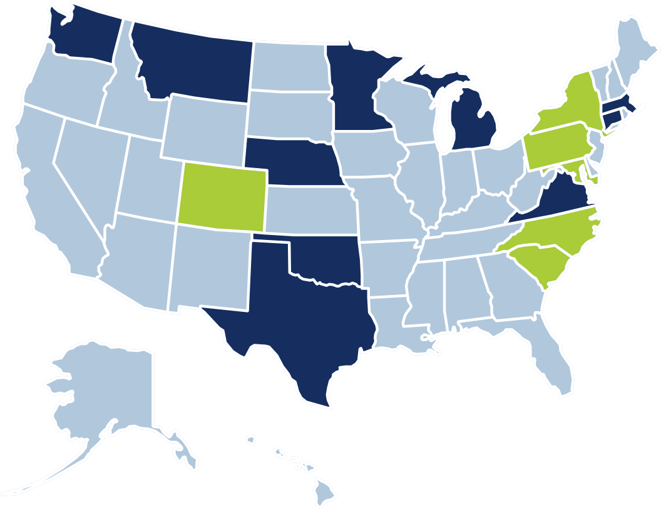
Where We Work
Policy and Practice Assistance to States*
Enrollment Assistance to Individuals + Policy and Practice Assistance to States*
*This map reflects BDT’s work in 2020

Slide 11
Toolkit: Increasing WIC Coverage Through Cross-Program Data Matching and Targeted Outreach
In recent years, more than 40 percent of eligible individuals have missed out on the Special Supplemental Nutrition Program for Women, Infants, and Children (WIC), despite the program’s well-documented dietary, health, and developmental benefits. Many of those missing out on WIC are enrolled in Medicaid or the Supplemental Nutrition Assistance Program (SNAP) which makes them automatically income-eligible, or “adjunctively eligible,” for WIC. This toolkit is designed to help state and local WIC agencies leverage data from Medicaid and SNAP to measure enrollment gaps and increase enrollment using tools to plan, launch, and/or strengthen data matching and targeted outreach to eligible families who are not receiving WIC benefits.

Slide 12
Toolkit: Increasing WIC Coverage Through Cross-Program Data Matching and Targeted Outreach
Completing this toolkit will help your team:
Set project goals for increasing WIC participation and enrolling a greater share of adjunctively eligible families;
Develop a comprehensive workplan for launching a data matching and targeted outreach initiative;
Plan an evaluation that measures progress toward goals and can guide improvements over time; and
Benefit from lessons learned in states that have matched Medicaid or SNAP data with WIC data to measure the enrollment gap and conduct targeted outreach.
Additional Resources
Using Data Matching and Targeted Outreach to Enroll Families With Young Children in WIC: Lessons Learned From State PilotsOpens in a new windowBenefits Data Trust and Center on Budget and Policy Priorities, January 5, 2021.
Outreach Landscape ExamplesOpens in a new windowThis resource provides descriptions of outreach in two states.
Examples published in Targeted Text Message Outreach Can Increase WIC Enrollment, Pilots ShowOpens in a new window, Benefits Data Trust and Center on Budget and Policy Priorities, June 10, 2021.
Learn more about the WIC toolkit at https://bdtrust.org/wic-toolkit-22/

Slide 13
DSA Playbook
Benefits Data Trust (BDT) is thrilled to announce the release of “Data Sharing to Build Effective and Efficient Benefits Systems: A Playbook for State and Local Agencies.” This resource is designed to support administering government agencies and other sectors like health care, higher education, and research entities scope and implement successful data sharing projects, with legal considerations in mind.
Learn more and download this playbook at https://bdtrust.org/bolstering-benefits-access-introducing-benefits-data-trust%E2%80%99s-new-data-sharing-playbook/
Also, BDT recently hosted a webinar featuring government officials who are leading impactful and innovative data sharing efforts. If you missed the webinar, you can still view the recording on this page.

Slide 14
SNAP – Medicaid Data Coordination
In 2022, BDT, with support from the Robert Wood Johnson Foundation, and in collaboration with the Center for Health Care Strategies, conducted a nationwide review of how SNAP and Medicaid programs within each state coordinate and share data. There were three key findings from the survey:
Integration is not necessary for data sharing across programs – states without integrated SNAP and Medicaid systems share data at almost the same rate as those with integrated systems.
States commonly share SNAP and Medicaid data with third parties; most often with Managed Care Organizations (MCOs) and non-profits.
Medicaid and SNAP data sharing occurs in states across the political spectrum, regardless of state size or region.

Slide 15
SNAP – Medicaid Data Coordination
WHAT’S NEXT
With this work, BDT and the Center for Health Care Strategies aim to improve access to services by providing actionable recommendations, tools, and technical assistance to individual state agencies navigating data-coordination issues. Throughout this two-year project, we will disseminate case studies, additional reports, and other announcements.
Download the first report and look for more to come at https://bdtrust.org/bridging-gaps-in-benefits-access-how-data-coordination-can-bolster-enrollment-across-programs/

